Slide 1
Aakash Goel https://www.linkedin.com/in/goelaakash123/
Session 7:
SIFT (Scale Invariant Feature Transform)
Acknowledgement: Slide Materials adopted from - Intro to Computer Vision (Cornell Tech); Noah Snavely, prepared by the lead instructor Prof S P Vimal , modified (added some content) by Aakash Goel

Slide 2
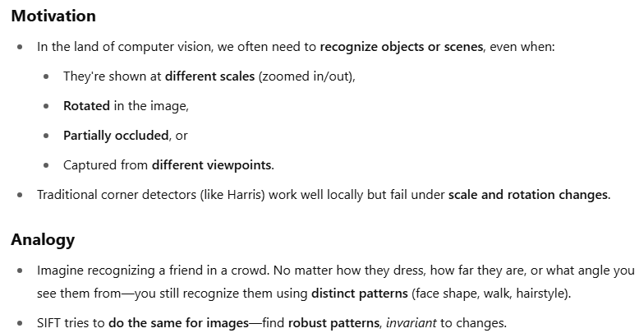
The Quest: Why Do We Need SIFT?

Slide 3
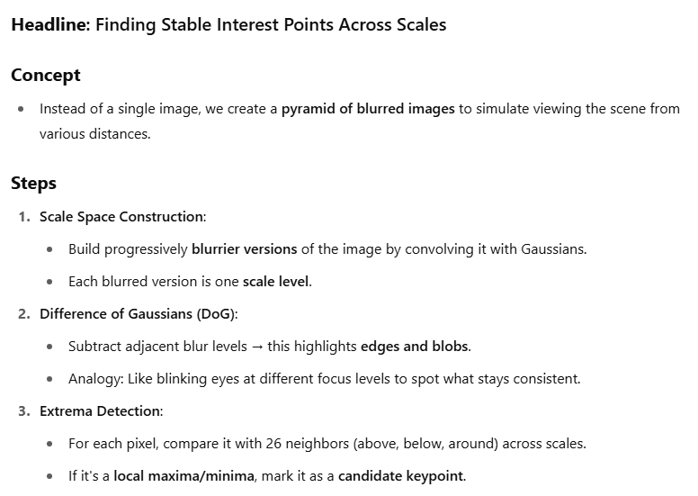
Meet the Hero: Keypoint Detection with Scale Invariance

Slide 4
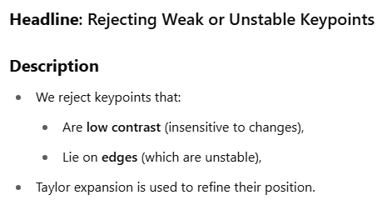
Polish the Hero: Keypoint Refinement

Slide 5
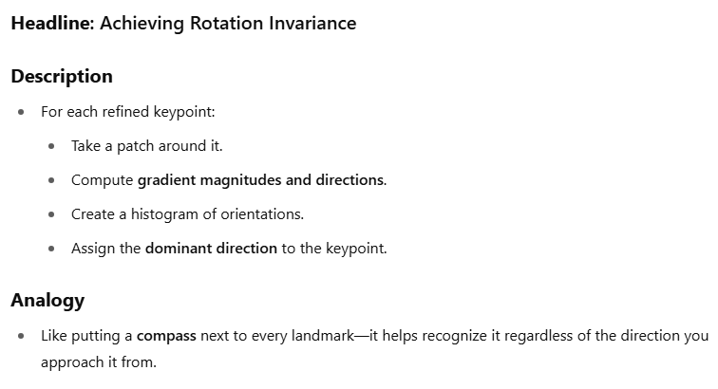
Make It Immortal: Assign Orientation

Slide 6
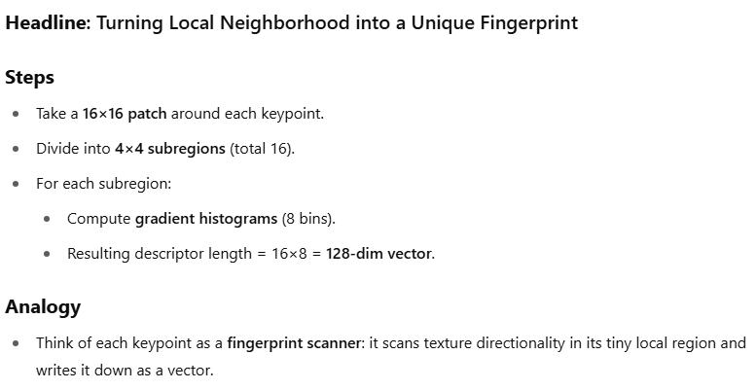
The Signature: Descriptor Generation

Slide 7
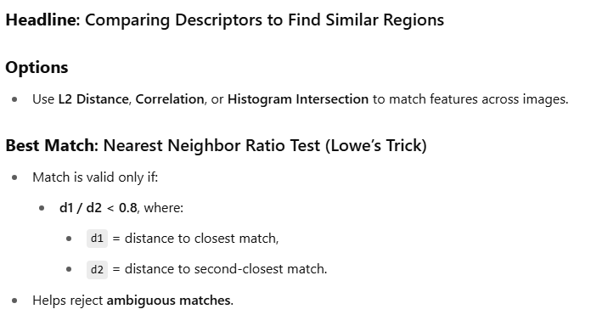
The Matchmaker: Feature Matching

Slide 8
SIFT - What
SIFT (Scale Invariant Feature Transform) Detector is used in the detection of interest points on an input image. It allows the identification of localized features in images which is essential in applications such as:
Object Recognition in Images
Path detection and obstacle avoidance algorithms
Gesture recognition, Mosaic generation, etc.

Slide 9
Motivation - SIFT
Why do we need something like SIFT?
In real-world images, objects may:
Appear at different scales (near vs. far),
Be rotated,
Be partially occluded,
Be taken under different lighting conditions.
We need feature descriptors that are:
Invariant to scale and rotation,
Robust to illumination and partial occlusion.

Slide 10
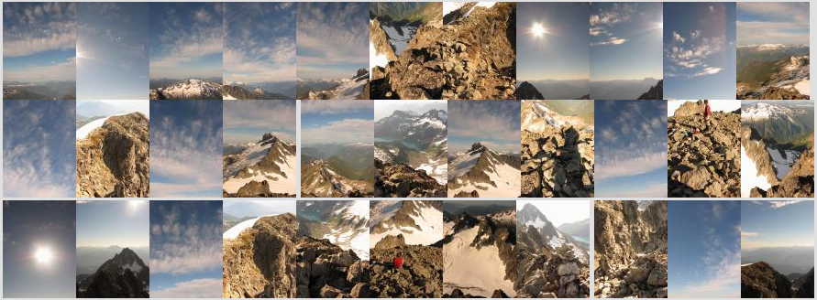
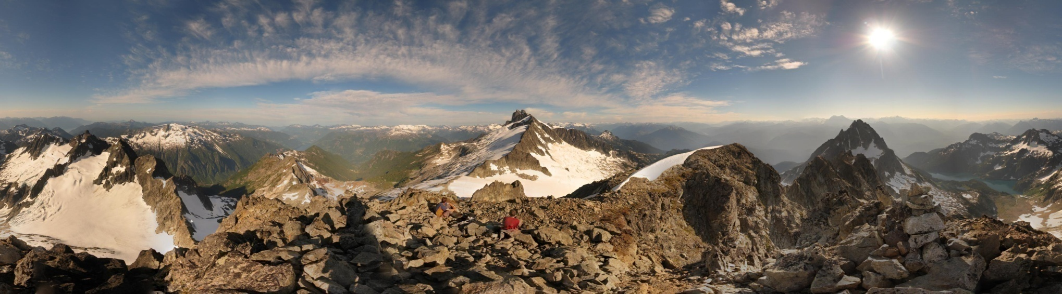
Motivation: Automatic panoramas
Credit: Matt Brown

Slide 11


Why extract features?
Motivation: panorama stitching
We have two images – how do we combine them?
Panorama stitching is the process of combining multiple overlapping images into a single wide-angle image. For example, when you take several pictures of a landscape by rotating your phone and want them stitched together into one seamless photo.

Slide 12


Why extract features?
Motivation: panorama stitching
We have two images – how do we combine them?
Step 1: extract features
Step 2: match features

Slide 13

Why extract features?
Motivation: panorama stitching
We have two images – how do we combine them?
Step 1: extract features
Step 2: match features
Step 3: align images

Slide 14
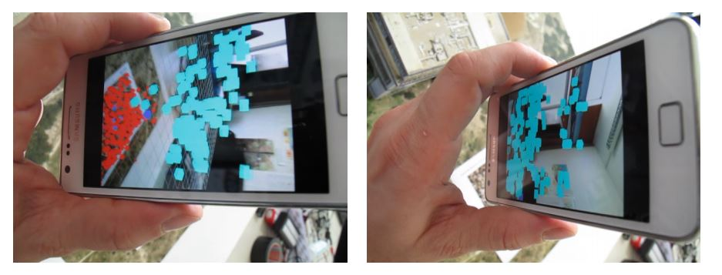
Application: Visual SLAM
(aka Simultaneous Localization and Mapping)

Slide 15
Visual SLAM
It's a technique used by robots, drones, and AR devices to:
Map the environment (build a 3D model or layout),
Localize themselves in that environment (figure out where they are),
All at the same time, and using only camera(s) (no GPS).
Think of it this way:
Imagine you're dropped in a dark unknown room with just a flashlight (your camera). You move around slowly and take pictures.
From these pictures:
You build a map of the room,
You also figure out your position in the room with each step.
That's Visual SLAM.

Slide 16
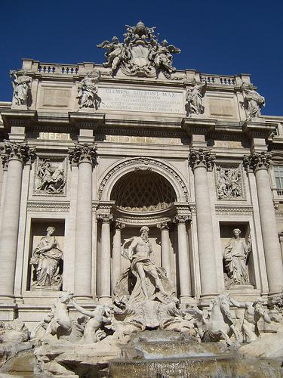
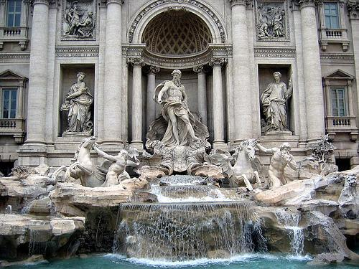
Image matching
Image Matching is the process of finding corresponding points (or regions) between two or more images that may depict the same scene, object, or pattern—but under different conditions.
by Diva Sian
by swashford

Slide 17
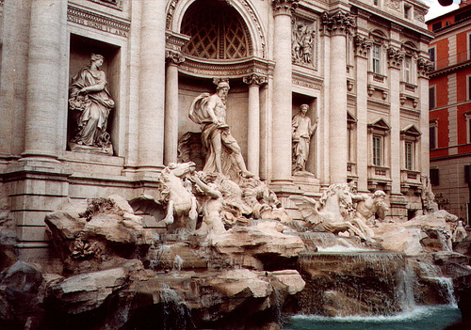
Harder case
by Diva Sian
by scgbt
Matching an image taken at a different angle, under different lighting, and at a different distance.
SIFT extracts keypoints and descriptors that are still matchable under all these variations.

Slide 18
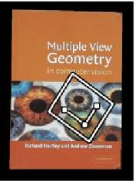

Feature matching for object search
Application of feature matching in identifying and locating objects within different contexts

Slide 19


Feature Matching
zooms in on the matched features from both images, showing how specific patterns or textures are identified and matched. This highlights the precision of feature matching in recognizing and locating objects based on distinct visual features, even when the object is part of a larger, more complex scene.

Slide 20
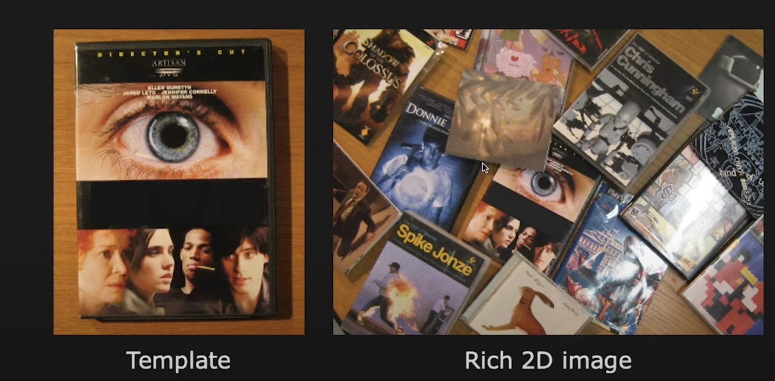
Object matching
Object matching using a template image.
Left image serves as a template, showing a specific object (a DVD cover), while the right image contains a cluttered scene with multiple objects, including the one from the template. The goal is to use feature matching techniques to identify and locate the template object within the complex scene

Slide 21
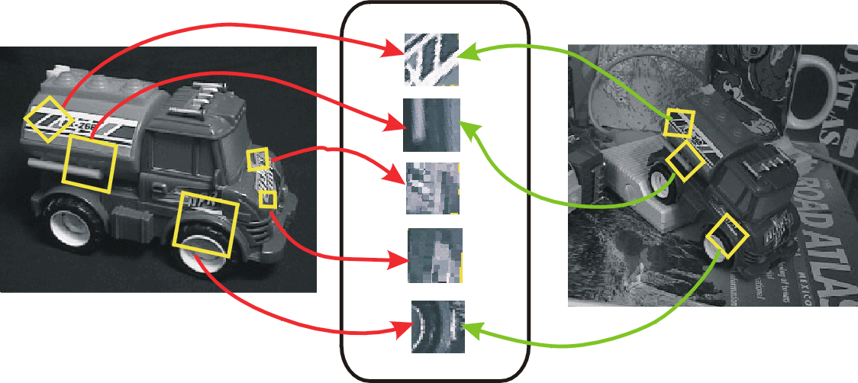
Invariant local features
CV 7: Scale Invariant Feature Transform
Find features that are invariant to transformations
geometric invariance: translation, rotation, scale
photometric invariance: brightness, exposure, …
Feature Descriptors

Slide 22
Advantages of local features
Locality
features are local, so robust to occlusion and clutter because they focus on small, distinct parts of an image, allowing for reliable detection even when parts of the object are hidden or surrounded by other objects.
Quantity
A single image can contain hundreds or thousands of local features, providing a rich set of data points for analysis and matching
Distinctiveness:
enabling the differentiation of objects within a large database
Efficiency
real-time performance achievable

Slide 23
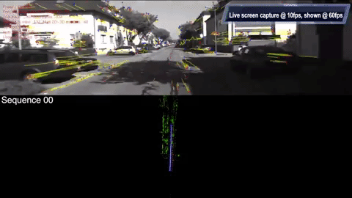
More motivation…
Feature points are used for:
Image alignment (e.g., mosaics)
3D reconstruction
Motion tracking (e.g. for AR)
Object recognition
Image retrieval
Robot/car navigation
… other

Slide 24
Approach
1. Feature detection: find it, identifying and locating distinctive features within an image. The goal is to find keypoints that are stable and can be reliably detected across different images.
2. Feature descriptor: represent it, Once features are detected, they are represented using descriptors. These descriptors capture the local image information around each keypoint, allowing for a unique and compact representation of the feature
3. Feature matching: match it, the descriptors are used to match corresponding features between different images. This is crucial for tasks like image alignment, object recognition, and 3D reconstruction.
4. Feature tracking: track it, when motion, feature tracking involves following the detected features across a sequence of images. This is important for applications such as video analysis and motion detection.

Slide 25
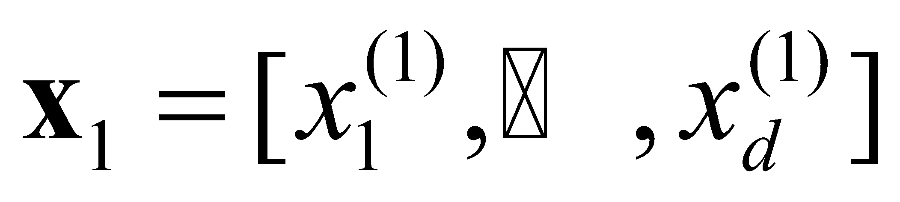
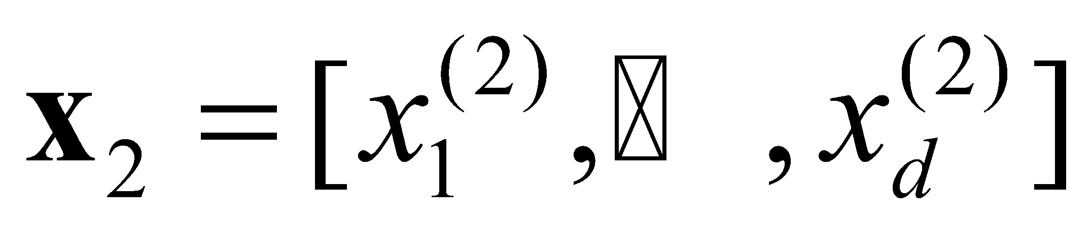
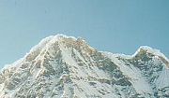
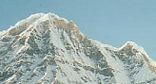
Local features: main components
Detection: Identify the interest points, which are distinctive and stable features that can be reliably detected across different images. (Technique: SIFT, Harris Corner Detector)
Description: Extract vector feature descriptor surrounding each interest point. These descriptors capture the local image information around the interest points, providing a unique representation. (Technique: histogram of gradient orientations)
Matching: Determine correspondence between descriptors in two views. matching the descriptors from one image to those in another, enabling tasks like image alignment and 3D reconstruction. (Technique: distance metrics like Euclidean distance or cosine similarity + RANSAC to filter out incorrect matches.)
Credit: Kristen Grauman

Slide 26
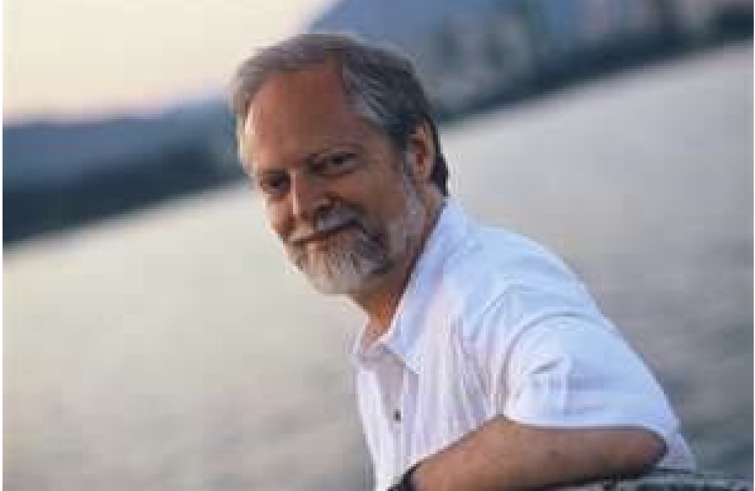
SIFT - Key point Extraction
Stands for scale invariant feature transform
Patented by university of British Columbia
Similar/mimics to the one used in primate visual system (human, ape, monkey, etc.)
Transforms image data into scale invariant coordinates, allowing it to detect features that remain consistent despite changes in scale, making it robust for various applications like object recognition and image matching.
David Lowe, UBC
D. Lowe. Distinctive image features from scale-invariant key points., International Journal of Computer Vision 2004.

Slide 27
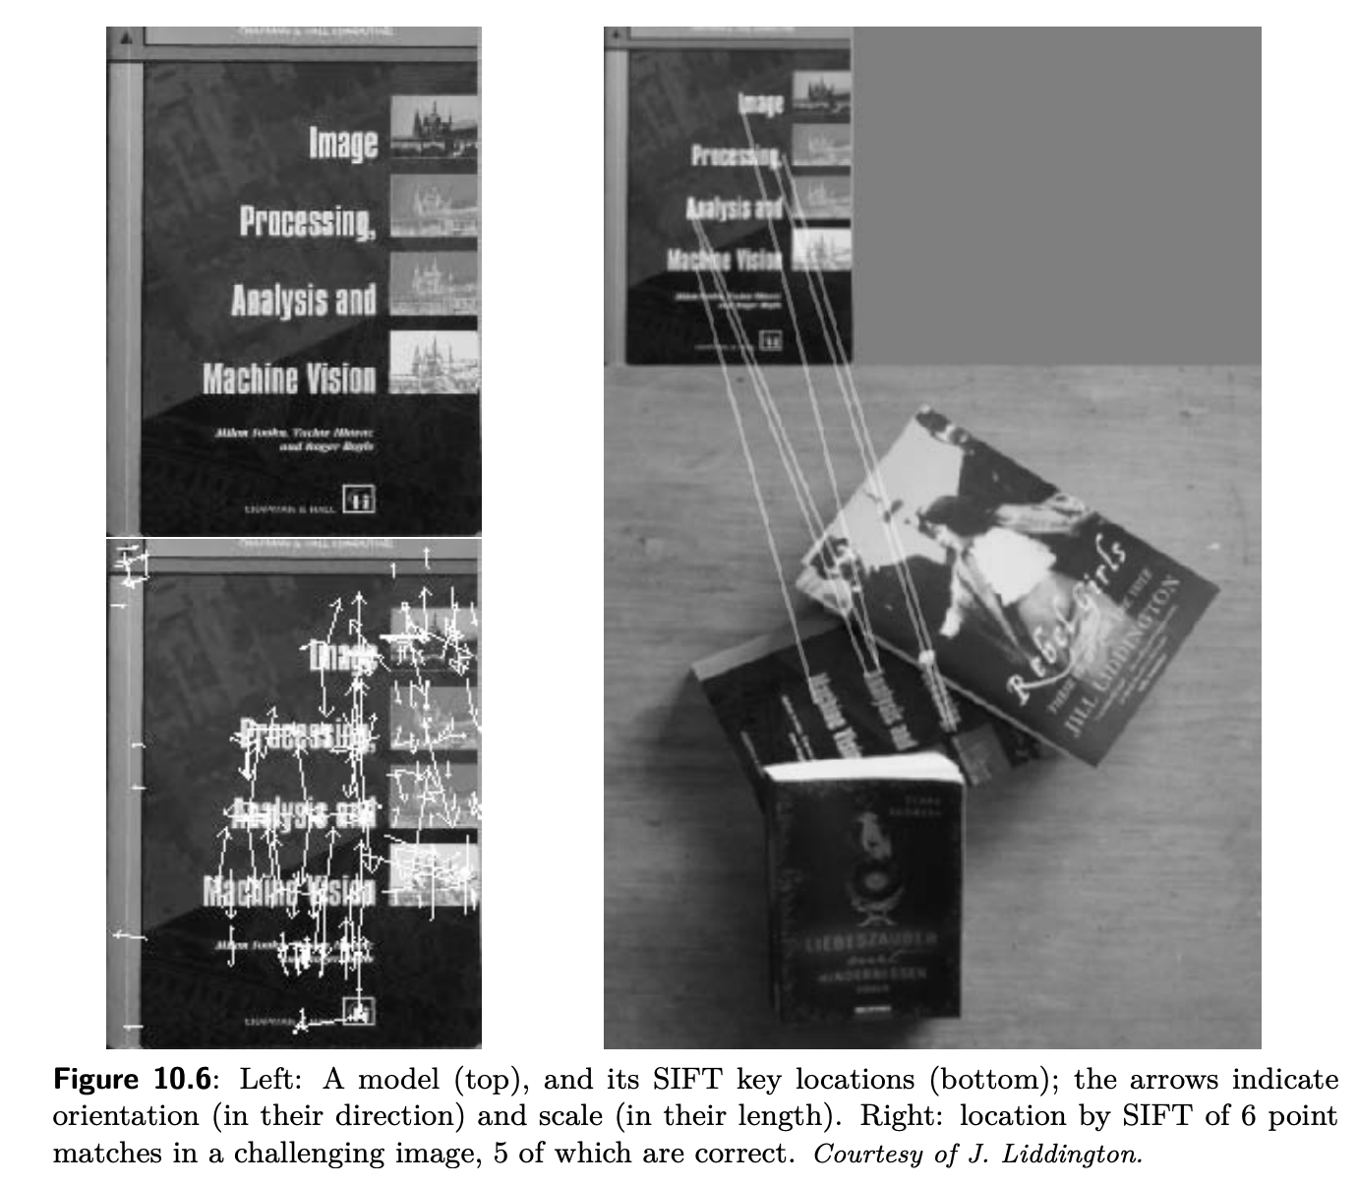
SIFT
SIFT Algorithm intuition
An analogy for understanding the SIFT algorithm is to think of it like a detective identifying and matching fingerprints at a crime scene:
Keypoint Detection: Imagine the detective is looking for fingerprints at a scene. These fingerprints are like the keypoints in an image—distinctive and unique patterns that stand out from the rest of the surface.
Descriptor Representation: Once a fingerprint is found, the detective analyzes its unique ridges and patterns, creating a detailed record. This is similar to how SIFT creates a descriptor for each keypoint, capturing the local image details.
Feature Matching: The detective then compares the recorded fingerprints with those in a database to find matches. Similarly, SIFT compares descriptors from different images to identify corresponding features, even if the fingerprints (or features) are smudged or partially visible.

Slide 28
Goal
Extracting distinctive invariant features
Correctly matched against a large database of features from many images
same features can be recognized even when they appear in different contexts or conditions.
Invariance to image scale and rotation - SIFT aims to detect features that remain consistent despite changes in scale (size) and rotation. This allows the algorithm to recognize objects regardless of how they are oriented or how far they are from the camera.
Robustness to
Affine distortion - SIFT is designed to handle distortions that occur when the image plane is tilted relative to the object.
Change in 3D viewpoint - The algorithm can recognize features even when the viewpoint changes, which alters the perspective of the object.
Addition of noise - SIFT is robust to noise, meaning it can still detect and match features even when the image quality is degraded.
Change in illumination - The algorithm can handle variations in lighting, ensuring that features are detected consistently under different illumination conditions.

Slide 29
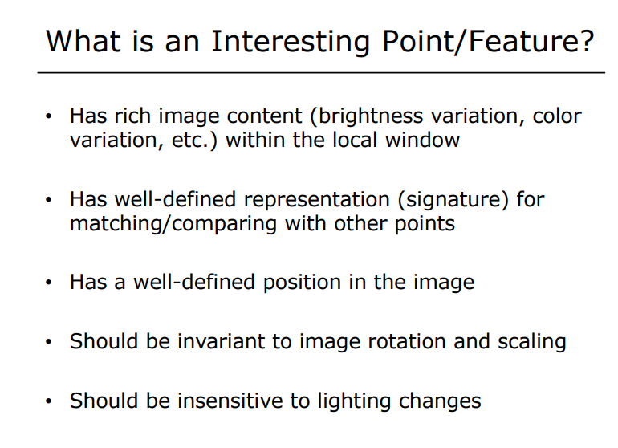

Slide 30
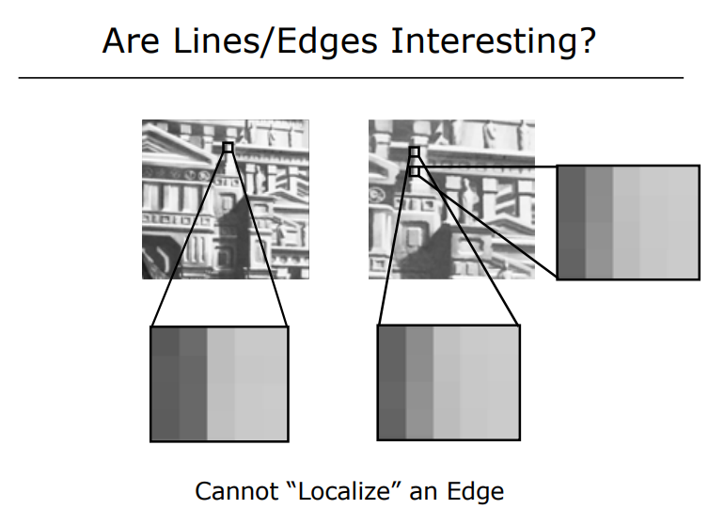
While edges are important for understanding image structure, their inability to be localized precisely makes them less suitable as "interesting" features for tasks that require exact matching or tracking, such as those performed by algorithms like SIFT. Instead, features with well-defined positions, such as corners or blobs, are typically preferred.

Slide 31
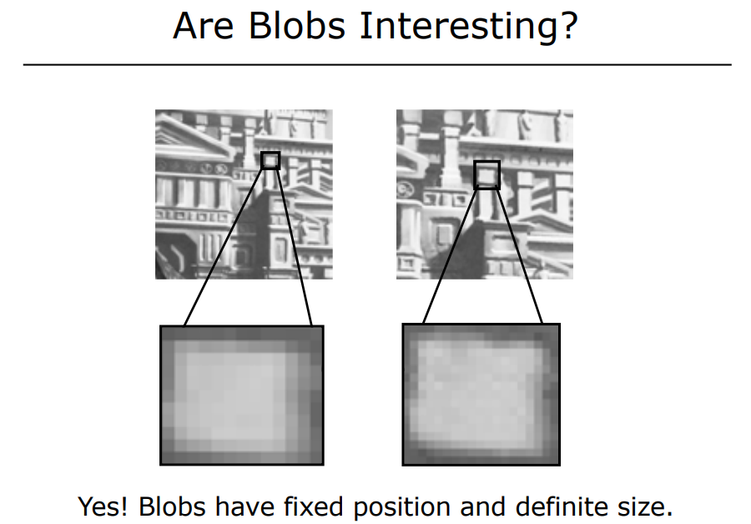
A blob is a patch or area of interest in an image that is identified at different scales. The term "blob" is used loosely to describe a patch with a local appearance is essentially a region in the image characterized by significant intensity changes, detected via scale-space analysis and refined for robustness
Scale Space: This is a conceptual framework used to analyze images at multiple scales. In scale-space analysis, an image is progressively blurred to create a series of images, each representing the original image at a different level of detail. This allows for the detection of features that are invariant to changes in scale, such as blobs.

Slide 32
What is Blob ?
"blob" refers to a region in an image that is visually distinct from its surroundings. Blobs are typically characterized by their uniformity in terms of intensity or color and are often used to identify and analyze features within an image. Here are some key aspects of blobs:
Definition: A blob is a connected region of pixels that share similar properties, such as brightness or color. Blobs can represent various features in an image, such as objects, parts of objects, or areas of interest.
Detection: Blob detection is a technique used to identify these regions within an image. It involves finding areas that differ significantly from their surroundings in terms of intensity or texture. Common methods for blob detection include:
Laplacian of Gaussian (LoG): This method involves smoothing the image with a Gaussian filter and then applying the Laplacian operator to detect regions of rapid intensity change.
Difference of Gaussians (DoG): This is an approximation of the LoG, where the image is smoothed with two different Gaussian filters, and the difference between the two results is computed.
Determinant of Hessian: This method uses the Hessian matrix to identify regions with high curvature, which often correspond to blobs.
Applications: Blob detection is used in various applications, including:
Feature Detection: Identifying key points or regions in images for tasks like object recognition, image matching, and tracking.
Medical Imaging: Detecting regions of interest, such as tumors or lesions, in medical scans.
Robotics and Navigation: Identifying landmarks or obstacles in the environment.
Scale-Space Analysis: Blobs can appear at different scales (features in an image can vary in size), so scale-space analysis is often used to detect blobs of varying sizes. This involves analyzing the image at multiple scales to ensure that blobs are detected consistently, regardless of their size.
Different scales refer to the various levels of detail at which an image is analyzed to detect features of different sizes

Slide 33
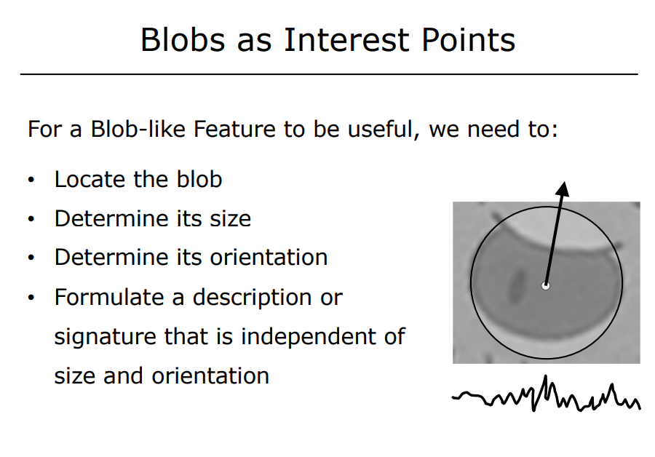

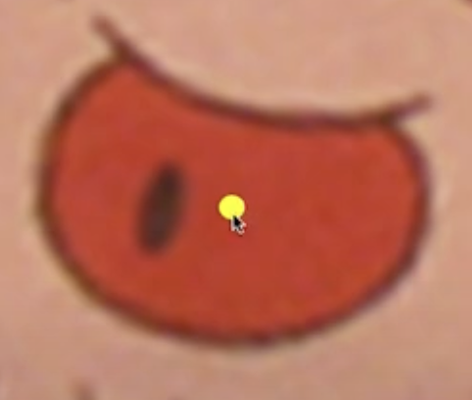
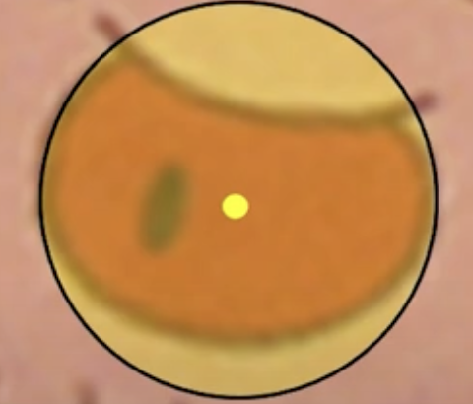

Slide 34
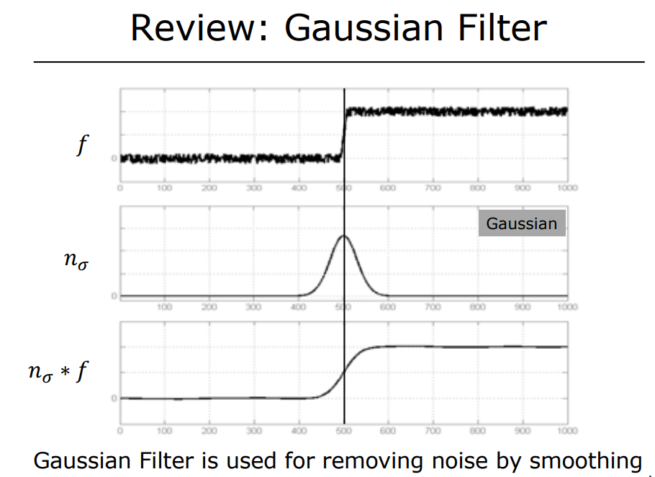
signal or image data that contains noise. The noise appears as random fluctuations superimposed on the underlying signal.
Gaussian function, characterized by its bell-shaped curve. The Gaussian function is defined by its mean and standard deviation, which determine the width and height of the curve. It is used as a smoothing kernel in filtering operations
Result of convolving the original signal ( f ) with the Gaussian filter. This operation smooths the signal, reducing the noise and preserving the important features. The convolution process effectively averages the values in the signal, weighted by the Gaussian function, to produce a cleaner output.

Slide 35
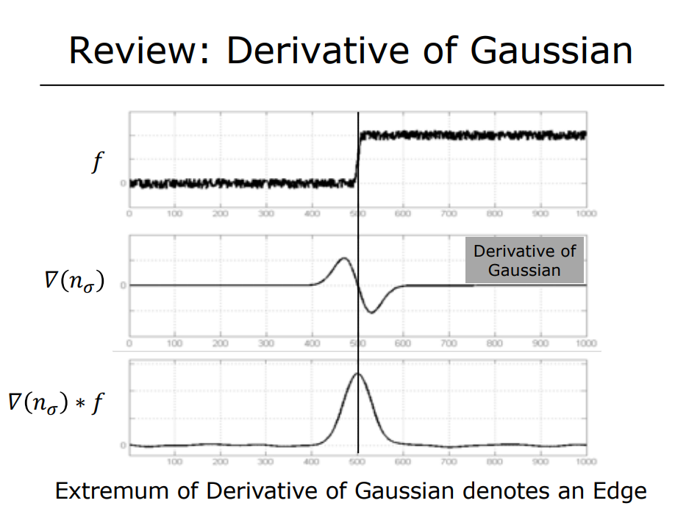
signal or image data that contains noise and a sharp transition, which could represent an edge in an image.
Used to highlight changes in intensity, such as edges, by emphasizing areas where the intensity gradient is highest. zero-crossing indicates the location of the maximum rate of change in intensity, which corresponds to an edge in the image. The positive lobe represents the region where the intensity is increasing, and the negative lobe represents the region where the intensity is decreasing
Result of convolving the original signal ( f ) with the derivative of the Gaussian.
This operation enhances the edges in the signal by highlighting areas of rapid intensity change.

Slide 36
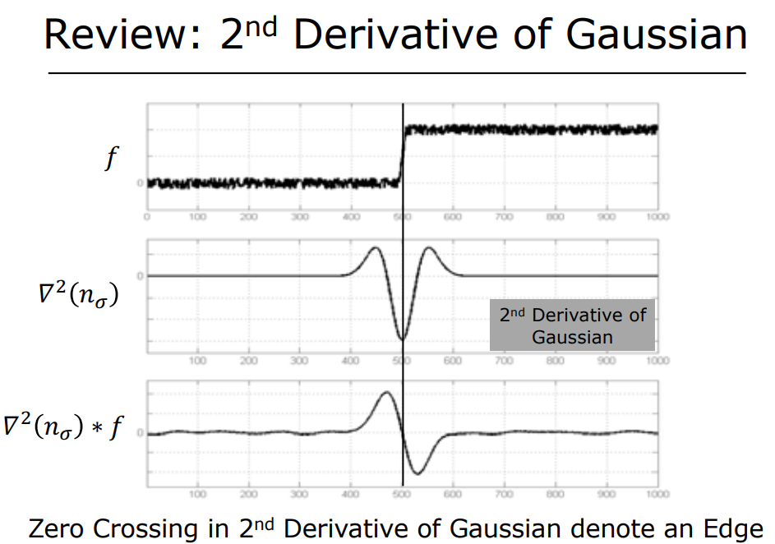
The second derivative of the Gaussian is used in edge detection algorithms like the Laplacian of Gaussian (LoG) to identify and localize edges in images. By focusing on the zero-crossings, it effectively isolates the boundaries between different regions, making it a powerful tool for detecting edges.
Second derivative of a Gaussian typically has a characteristic shape with a positive lobe, a zero-crossing, and a negative lobe.
This operation enhances the edges by emphasizing the points of maximum curvature in the intensity profile. Zero-crossing is the point where the function changes sign, indicating a transition from a positive to a negative slope or vice versa. This is a strong indicator of an edge, as it corresponds to the point of maximum curvature or the inflection point in the intensity profile.

Slide 37
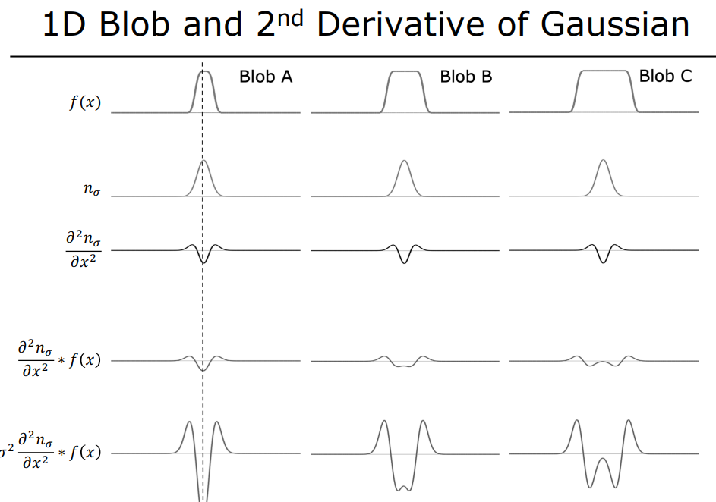
Three blobs (A, B, and C) of different sizes.
Second row displays the Gaussian function at a particular scale (\sigma). This function is used to smooth the original signal.
When you analyze features at different scales, the response of the convolution can vary depending on the scale. By normalizing, you adjust the response so that it is consistent across different scales. This means that the same feature (e.g., a blob) will produce a similar response regardless of its size in the image.

Slide 38
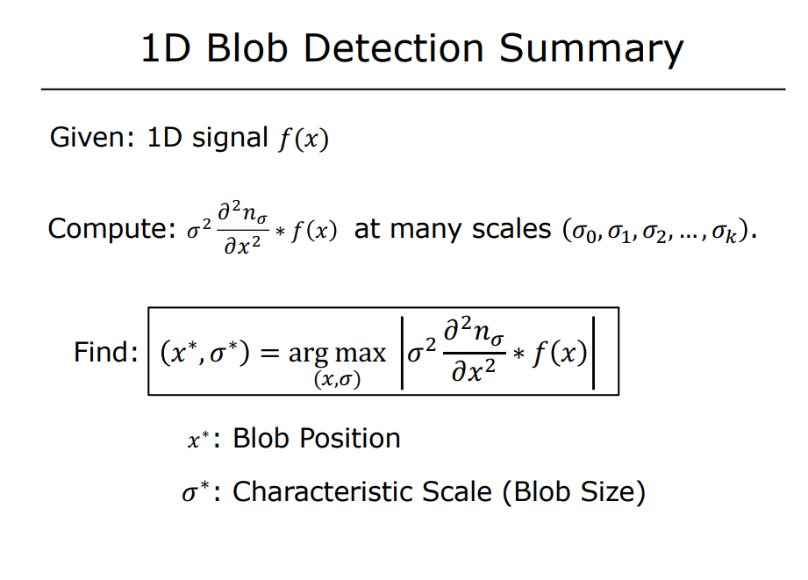
This operation emphasizes regions in the signal where there are significant changes, which are potential blob locations. is to analyze the signal at multiple scales to detect features of different sizes.
The (argmax) operation identifies the location and scale of the most prominent blob in the (x, sigma)-space.

Slide 39
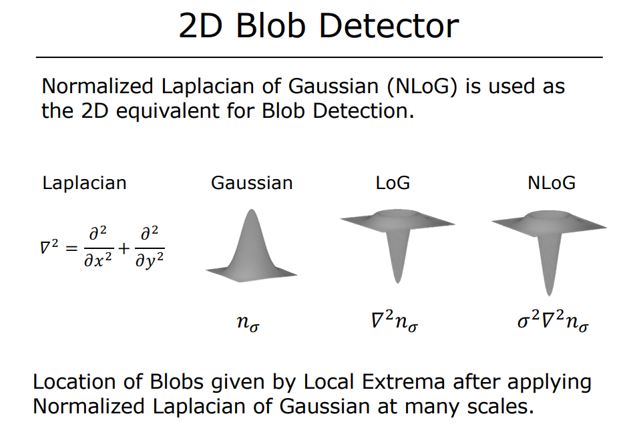
LoG highlights regions in the image where there are significant changes in intensity, such as blobs.
This normalization ensures that the response is consistent across different scales, making the detection process scale-invariant. It allows for the detection of blobs of varying sizes in a robust manner.
It is used to detect regions of rapid intensity change, which are indicative of edges or blob-like features in an image.

Slide 40
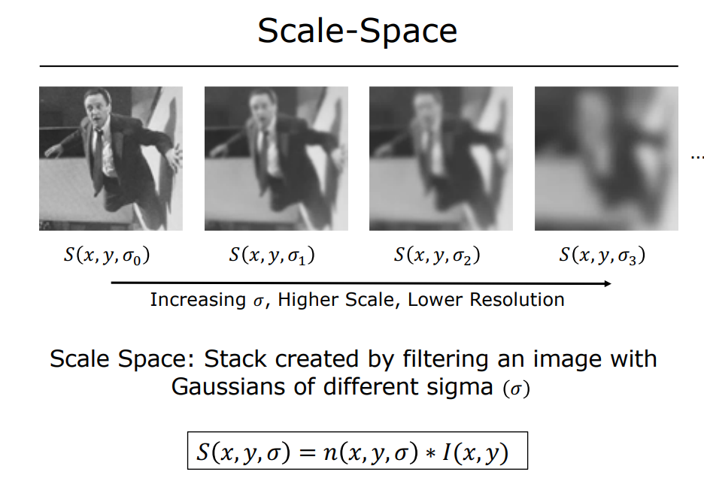
concept of scale-space, which is a fundamental technique in image processing and computer vision for analyzing images at multiple scales.
Scale-space is a framework for representing an image at various levels of detail. It is created by filtering the image with Gaussian functions of different standard deviations.
The result is a stack of images, each corresponding to a different scale, where smaller sigma values represent finer details and larger sigma values represent coarser details.
This blurring effect helps in analyzing larger structures in the image while suppressing smaller details.
Convolving the original image (I(x, y)) with a Gaussian function.

Slide 41
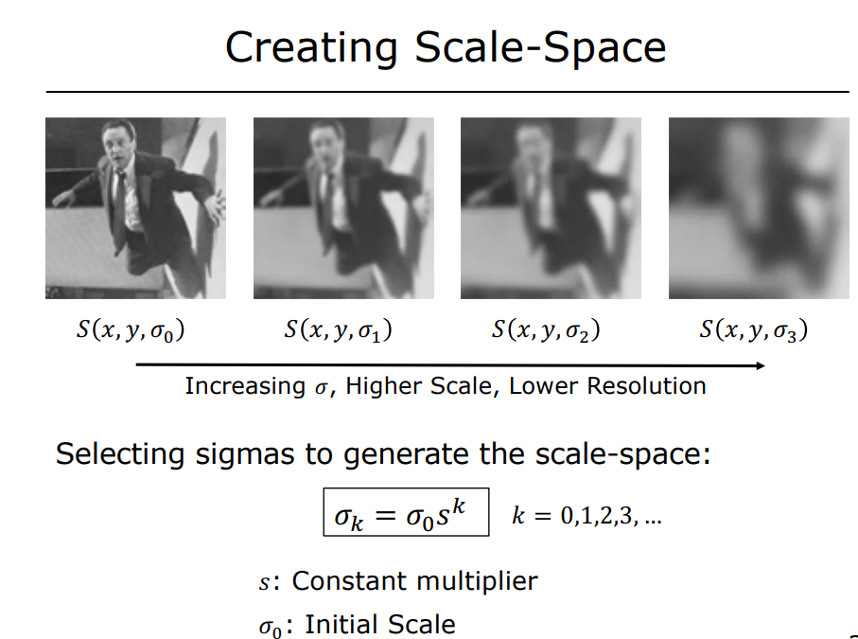
create a scale-space representation of an image by selecting appropriate sigma values for Gaussian filtering
This formula allows for a systematic way to increase the scale by multiplying the initial sigma by a constant factor (s) raised to the power of (k). Generates sigma values in a geometric progression This ensures that the scales are evenly spaced in a logarithmic sense, which is useful for capturing features of varying sizes.

Slide 42
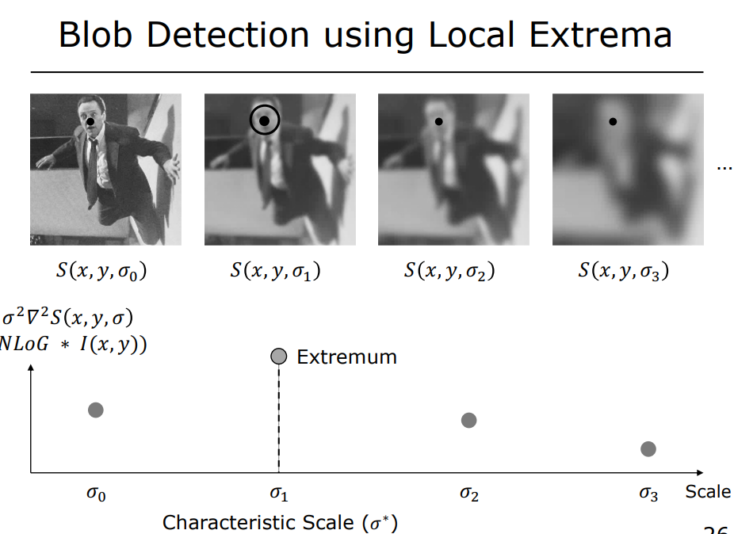
scale-invariance, allowing for consistent detection of blobs across different scales.
Blobs are detected by identifying local extrema (either maxima or minima) in the response of the NLoG across the scale-space. These extrema indicate the presence of blob-like features. At sigma1, indicating the characteristic scale (\sigma^*) at which the blob is most prominent.
This characteristic scale provides information about the size of the blob, helping to distinguish between features of different sizes.

Slide 43
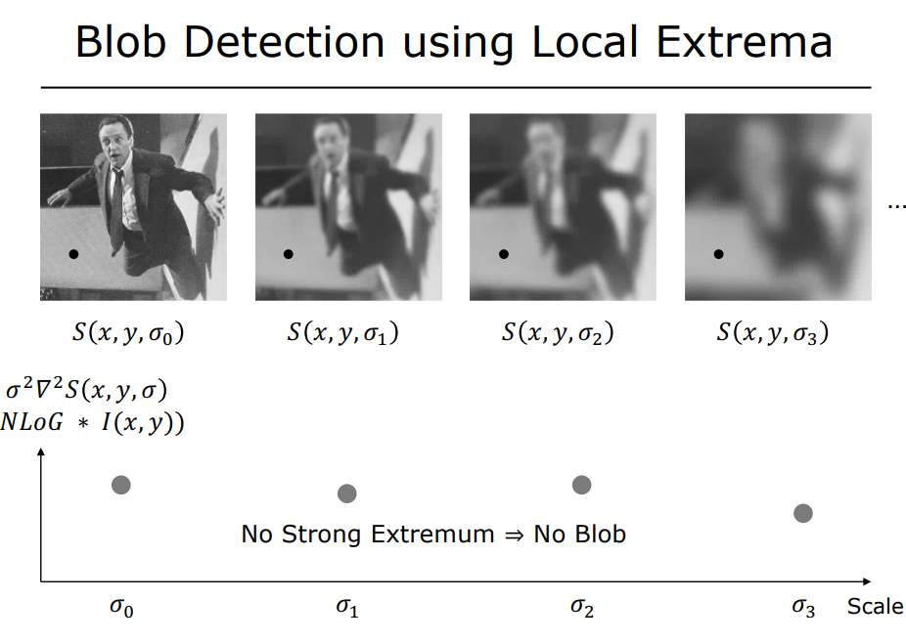

Slide 44
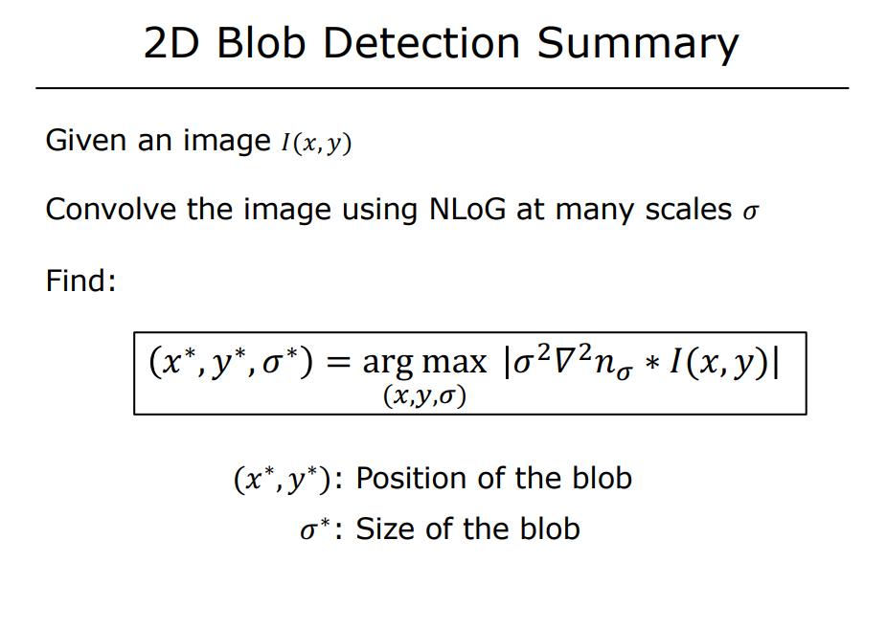

Slide 45
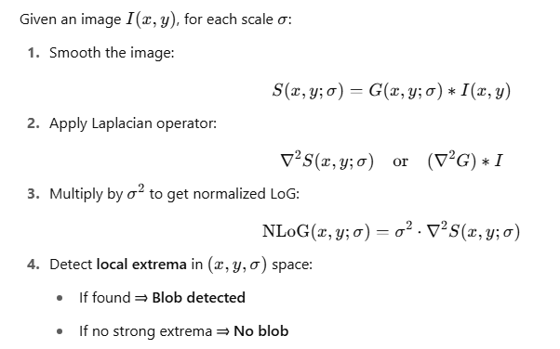
Summary of Math

Slide 46
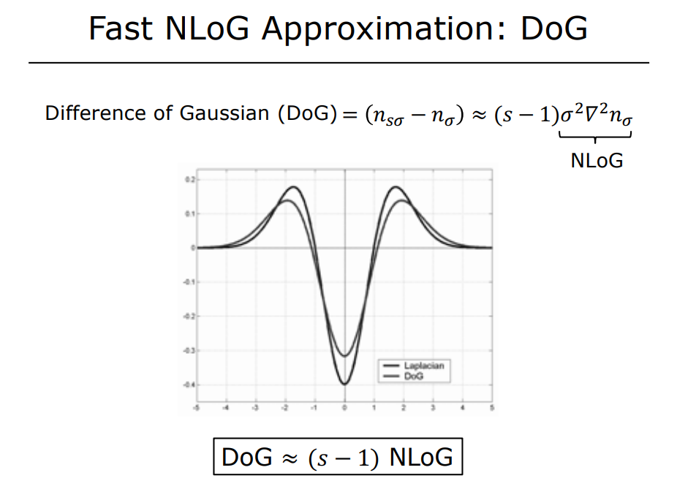
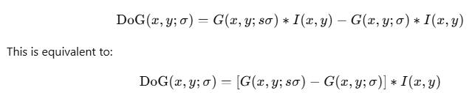
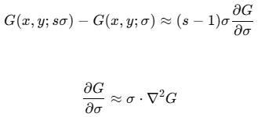
Motivation: We want to detect blobs (regions of interest with different brightness surrounded by contrasting areas) in images in a scale-invariant way.
The best operator for blob detection is the Laplacian of Gaussian (LoG), but it’s expensive to compute for every pixel and scale.
So, we use Difference of Gaussian (DoG) as a fast approximation to the Normalized LoG.
In DOG, Instead of applying the second derivative, we just subtract two Gaussians with nearby scales:
When the scaling factor s is close to 1, the DoG closely approximates the normalized Laplacian of Gaussian.

Slide 47
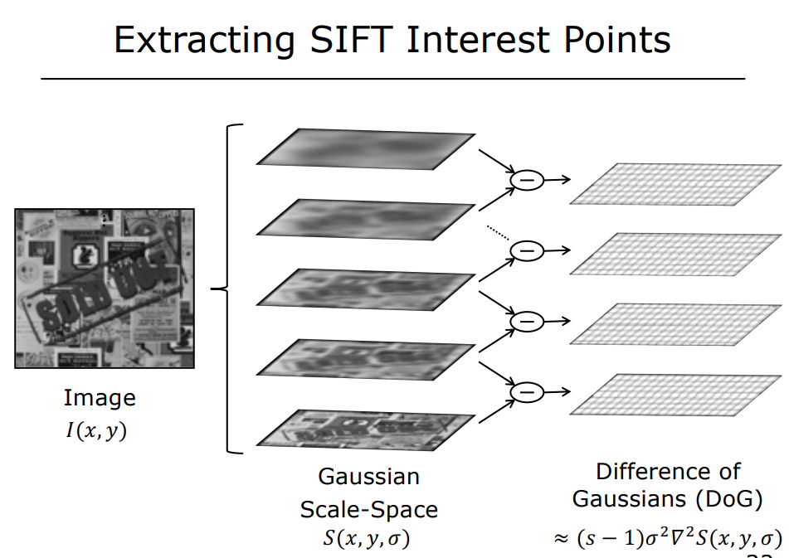

Slide 48
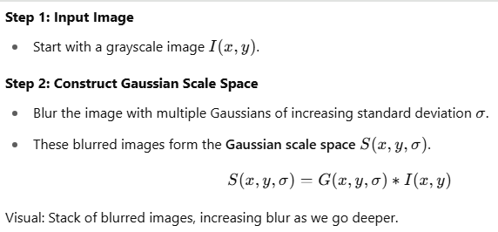
SIFT Interest Point Detection using Difference of Gaussians
Motivation: Want to extract features because we need stable, repeatable, and distinctive points in images for tasks like Panorama stitching, Object recognition, Visual SLAM, Image retrieval

Slide 49
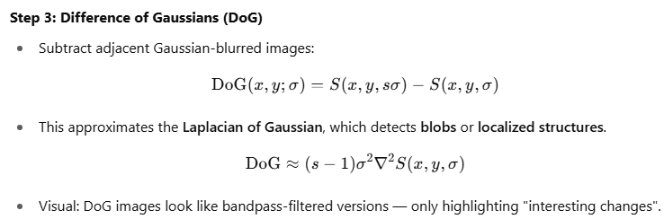
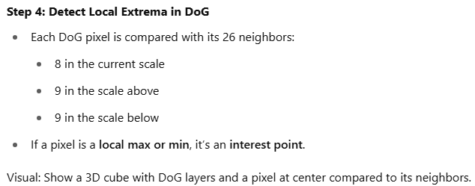
SIFT Interest Point Detection using Difference of Gaussians

Slide 50
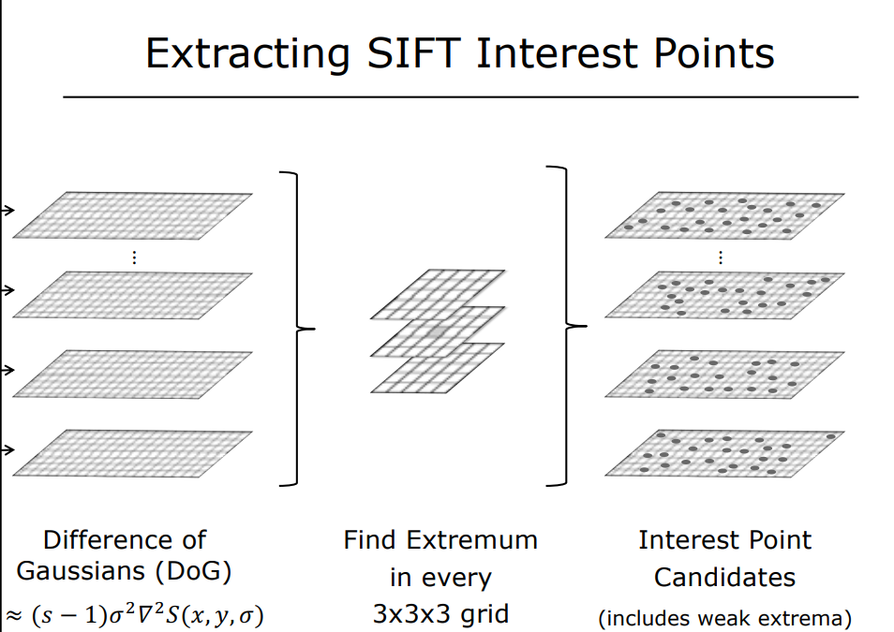

Slide 51
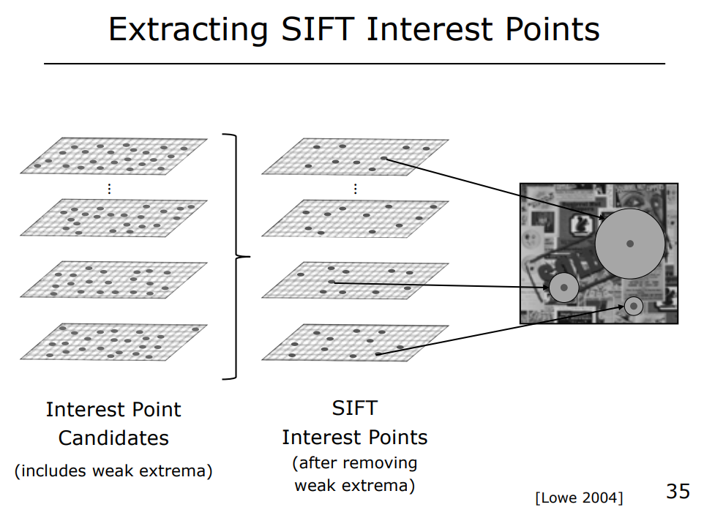

Slide 52
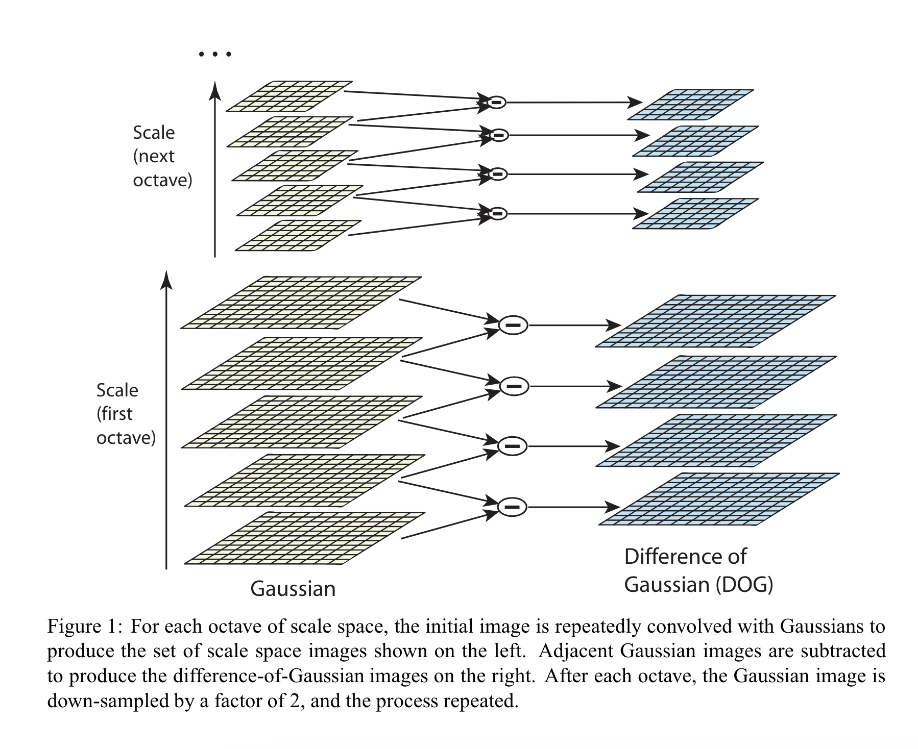
Difference of Gaussian
https://www.cs.ubc.ca/~lowe/papers/ijcv04.pdf

Slide 53

Difference of Gaussians visualisation
https://www.analyticsvidhya.com/blog/2019/10/detailed-guide-powerful-sift-technique-image-matching-python/

Slide 54






SIFT: Subpixel Keypoint Refinement (Taylor Expansion)
Filter out unstable keypoints — i.e., those that may arise from edges, noise, or low contrast.

Slide 55

Keypoint localization

Slide 56

SIFT: Orientation Assignment

Slide 57

SIFT: Descriptor Formation

Slide 58

The SIFT descriptor is formed by creating histograms of gradient directions over spatial regions around each keypoint.
A 16x16 window is divided into smaller 4x4 subregions, and each subregion's gradient directions are binned into histograms, resulting in a 128-dimensional vector.

Slide 59

Key point descriptor
CV 7: Scale Invariant Feature Transform

Slide 60


Keypoint descriptor
CV 7: Scale Invariant Feature Transform

Slide 61


SIFT: Descriptor Normalization

Slide 62

how SIFT detects keypoints at different scales using the scale-space representation.
The ratio represents the relative sizes of blobs detected in different images, demonstrating scale invariance.

Slide 63

Image gradients are computed around each keypoint to determine the direction and magnitude of intensity changes.
A histogram of gradient directions is created, and the most prominent direction is chosen as the principal orientation. This helps achieve rotation invariance.

Slide 64

The principal orientation is used to align the keypoint descriptor, effectively undoing any rotation in the image. This ensures that the descriptor is invariant to rotation.

Slide 65

Rotation Invariation using principal orientation

Slide 66



After extracting the 128-dimensional SIFT descriptors for keypoints, we need a way to compare them across images. Each method here measures similarity differently:

Slide 67



Slide 68

Normalized Correlation Example

Slide 69

Intuition:
Measures the overlap between two descriptors.
Works well when descriptors are seen as histograms or non-negative vectors.

Slide 70
Summary Comparison
Metric | Better Match When | Robust to Illumination? | Emphasis
L2 Distance | Smaller | No | Magnitude & direction
Normalized Correlation | Larger | Yes | Relative variation (shape)
Intersection | Larger | Somewhat | Shared presence of features

Slide 71

Sample Quiz

Slide 72


Slide 73


Slide 74


Slide 75


Slide 76


Slide 77
References
https://www.cs.ubc.ca/~lowe/papers/ijcv04.pdf
https://fpcv.cs.columbia.edu/Monographs
Image Processing, Analysis and Machine Vision, Milan Sonka, Vaclav Hlavac, Roger Boyle, 4th Edition, Sections 10.2 and 10.3
https://www.educative.io/answers/what-is-sift
Notebook
https://github.com/mithunkumarsr/LearnComputerVisionWithMithun/blob/main/CV7_SIFT_feature_matching.ipynb

